Slide 1


Erbium Doped Fiber Amplifier (EDFA) Gain Modeling by Machine Learning
By Anil Kumar Raigar
Supervisor: Md Saifuddin Faruk
https://github.com/anilkrp/EDFA_Gain_Modelling_Dissertation

Slide 2
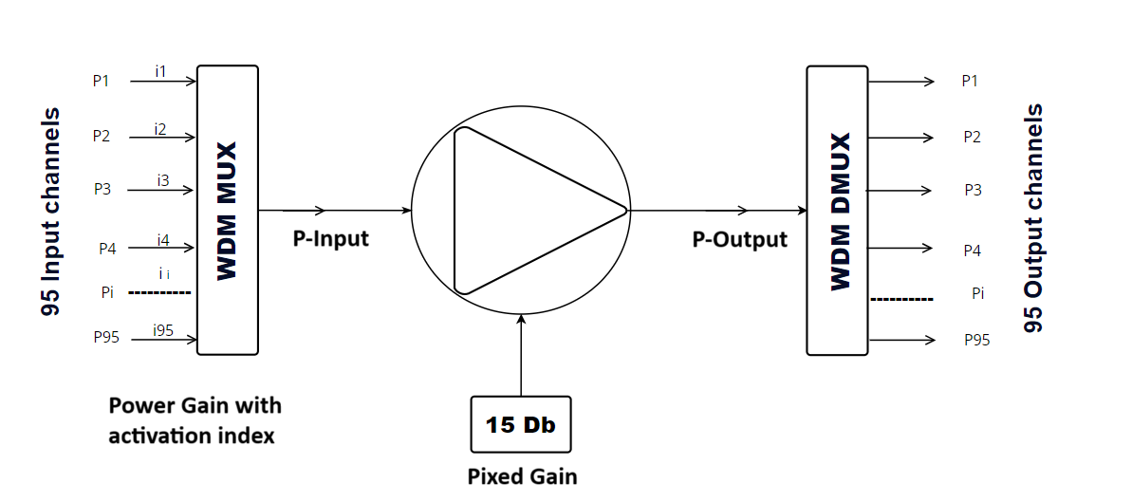
Project Setup and Initial Research
EDFA Gain Modeling: Discussed the problem and challenges of EDFA gain modeling with my supervisor.
Research & Dataset: Reviewed research papers and identified the relevant dataset (COSMOS-EDFA) for the project.
Dissertation Tasks: Defined key objectives with my supervisor, focusing on using DNNs to improve EDFA gain prediction accuracy.
The diagram illustrates the EDFA Power Gain Model, showing how 95 input channels are amplified to 95 output channels through a WDM Multiplexer and Demultiplexer, with a fixed gain of 15 dB applied in the amplification process.

Slide 3
Data Collection
Dataset Size: The dataset is over 3GB with more than 300 columns, providing a wealth of detailed information.
Data Complexity: It contains important measurements like input/output power and channel data, useful for analyzing optical systems.
Easy Format: The data was originally in JSON format and has been converted to CSV for easier analysis.
Features Used: effective_input_power, power_index, output_power, and gain for each of the 95 channels.
Dataset Name | Shape (Rows, Columns) | Memory (MB) | % of Total
Train | (128688, 285) | 377.02 MB | 86.01%
test_random | (10560, 285) | 30.94 MB | 7.06%
test_goalpost | (10368, 285) | 30.38 MB | 6.93%
Total Memory Usage: 438.33 MB

Slide 4
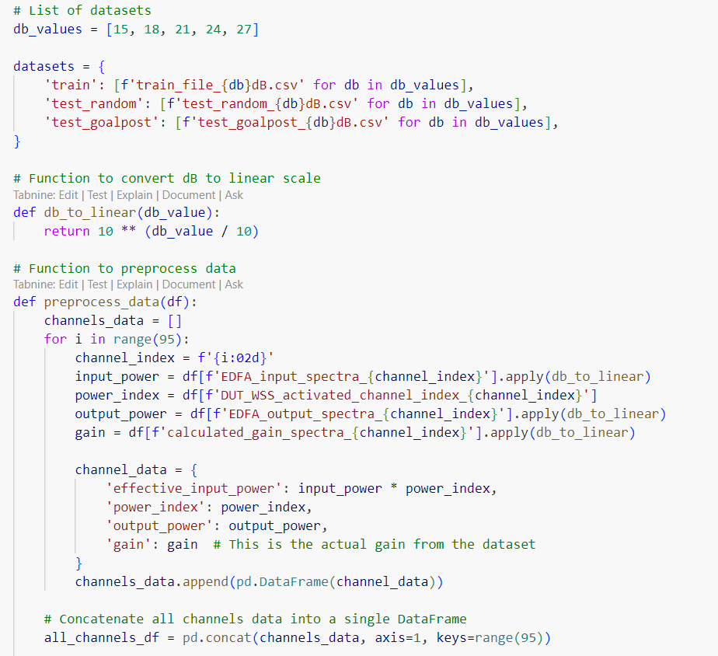
Data Preprocessing - I
Dataset Generation: Creates file names for different gain levels (15 dB to 27 dB).
Conversion: Converts dB values to a linear scale using db_to_linear function.
Preprocessing: Extracts input power, output power, and gain from the dataset, applies conversion, and stores results for 95 channels.
Output: Merges all channel data into a consolidated DataFrame for easy use in machine learning models.
This code preprocesses data for machine learning-based modelling of EDFA gain characteristics. It converts decibel values to linear scale and prepares a dataset with input power, output power, and gain values for 95 channels. The data is consolidated into a single DataFrame for further analysis and training. The structure is designed for scalable handling of multiple datasets.

Slide 5
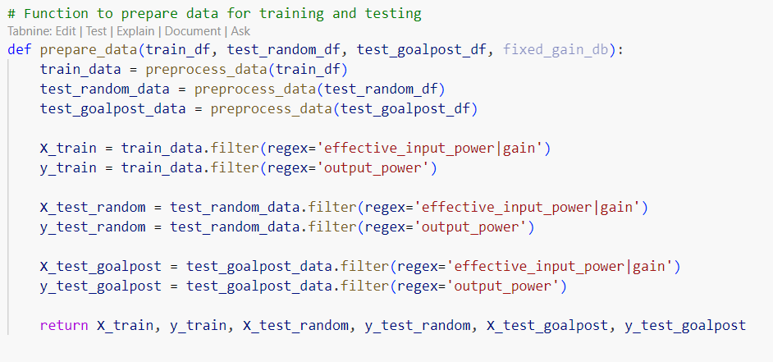
Data Preprocessing - II
Data Preprocessing: Calls preprocess_data() to process training, random test, and goalpost test datasets.
Feature Extraction: Filters the data to extract features (effective_input_power and gain) and target values (output_power).
Data Splitting: Splits data into training and testing sets for model evaluation.
Output: Returns the feature and target sets for both random and goalpost tests, allowing the model to be trained and tested.
This function prepares data for training and testing a machine learning model by preprocessing input datasets and splitting them into feature sets (X) and output targets (y) for different test cases, including random and goalpost tests.

Slide 6
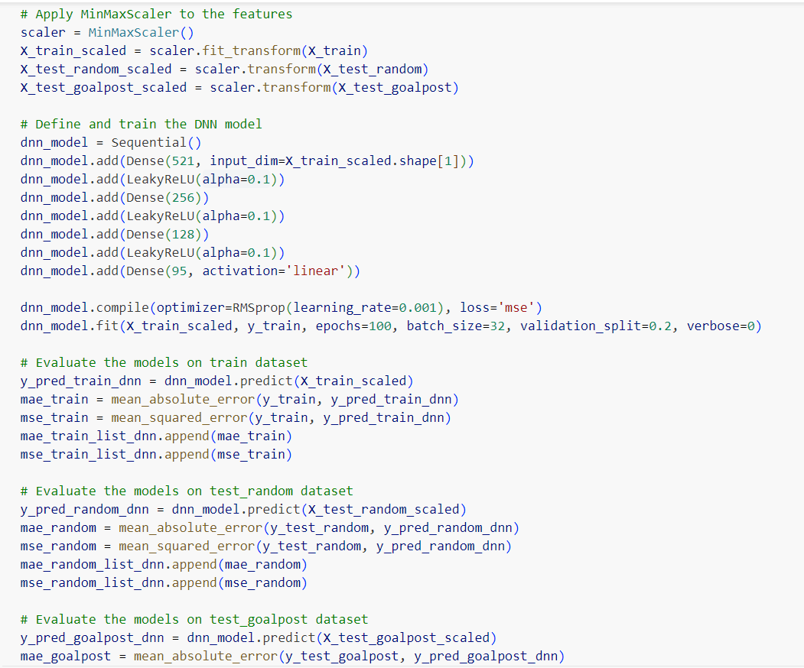
DNN Model
Scales features using MinMaxScaler for train, random, and goalpost datasets.
Defines a Deep Neural Network (DNN) with LeakyReLU activation functions.
Compiles the model using the RMSprop optimizer and MSE loss function.
Trains the model on the scaled training data with a validation split.
Evaluates the model’s performance using MAE and MSE on training, random, and goalpost test datasets.
This code scales features, defines and trains a DNN model, then evaluates its prediction performance using MAE and MSE across training and test datasets.

Slide 7
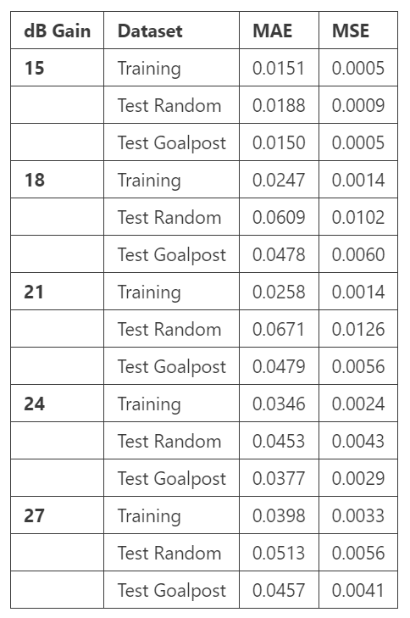
Model Development and Training
Training: Trained the model with RMSprop optimizer for 100 epochs using MSE as the loss function.
Evaluation: Assessed model performance on training, random, and goalpost datasets (MAE and MSE).
Predictions: Stored actual and predicted EDFA gain values for comparison.
This table shows the model’s performance for different dB gain levels. It lists the Mean Absolute Error (MAE) and Mean Squared Error (MSE) for the training, test random, and test goalpost datasets, helping to compare how well the model predicted EDFA gain in each case.

Slide 8
Thank
You

